Slide 1












EuPEO 3rd Transnational Project Meeting
Ljubljana, 25-28 September 2019

Slide 2

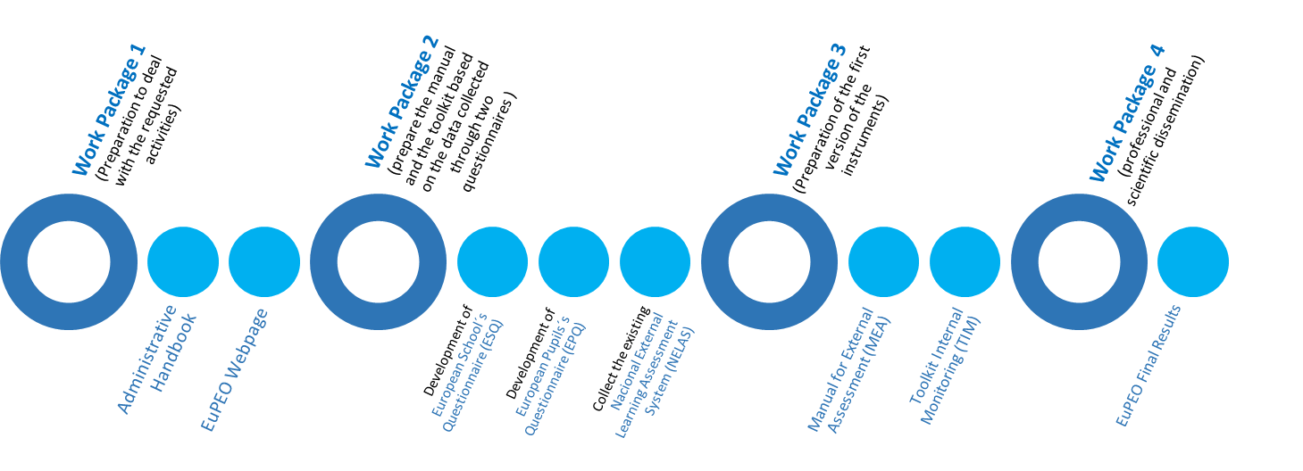
EuPEO
3rd Transnational Project Meeting
Ljubljana, 25-28 September 2019

Slide 3
EuPEO
3rd Transnational Project Meeting
Ljubljana, 25-28 September 2019
EuPEO Project, Part 2 - Activity 22 (cf. Project timeline)
Meeting number | 3
Dates and venue | September 2019, Ljubljana (UL)
Description of the meeting | 4 days meeting for the preparation of the different partners to pilot the EuPEO MEA and EuPEO TIM in each country.

Slide 4
EuPEO
3rd Transnational Project Meeting
Ljubljana, 25-28 September 2019

Slide 5
EuPEO
3rd Transnational Project Meeting
Ljubljana, 25-28 September 2019
25th September
(2:30 pm – 7:00 pm)
Assessment of the work since Paris
Presentation of the Global proposal for EuPEO: MEA and TIM parts and integration

Slide 6
EuPEO
3rd Transnational Project Meeting
Ljubljana, 25-28 September 2019
25th September (2:30 pm – 2:45 pm)
Welcome and Logistic Information
by Gregor Jurak (UL/FS),
Marcos Onofre (FMH) &
João Costa (SPEF)

Slide 7
EuPEO
3rd Transnational Project Meeting
Ljubljana, 25-28 September 2019
25th September (2:45 pm – 3:15 pm)
Administrative Issues since Paris
By Marcos Onofre & Dora Carolo (FMH)

Slide 8
EuPEO
3rd Transnational Project Meeting
Ljubljana, 25-28 September 2019
25th September (2:45 pm – 3:15 pm)
Information from the administrative responsible (reports, timesheets, ...) - Marcos
Information on the present situation of the on-line instruments, technical reports, ....) - Dora

Slide 9
Split Budget by Partner - Total
EuPEO
3rd Transnational Project Meeting
Ljubljana, 25-28 September 2019
Notes:
Presentation slide 1 – with EuPEO logo at the bottom

Slide 10
Split Budget by Partner - 2019
EuPEO
3rd Transnational Project Meeting
Ljubljana, 25-28 September 2019
Notes:
Presentation slide 1 – with EuPEO logo at the bottom

Slide 11
Financial Reporting
EuPEO
3rd Transnational Project Meeting
Ljubljana, 25-28 September 2019
Based on information received
Notes:
Presentation slide 2 – with EuPEO logo at the top

Slide 12
Expenditure - General
EuPEO
3rd Transnational Project Meeting
Ljubljana, 25-28 September 2019
Notes:
Presentation slide 2 – with EuPEO logo at the top

Slide 13
Information Received by Partner
– Periodic Reports
EuPEO
3rd Transnational Project Meeting
Ljubljana, 25-28 September 2019
Notes:
Presentation slide 2 – with EuPEO logo at the top

Slide 14
Information Received by Partner
– Timesheets
EuPEO
3rd Transnational Project Meeting
Ljubljana, 25-28 September 2019
Notes:
Presentation slide 2 – with EuPEO logo at the top

Slide 15
Proposal for financial aspects agreed in last meeting
EuPEO
3rd Transnational Project Meeting
Ljubljana, 25-28 September 2019
Send by May the 4th quarterly report and signed timesheets
Send September 5th quarterly report and signed timesheets
End January the 6th quarterly report and signed timesheets
Not done by all partners the 4th and 5th reports
Please send timesheets by post to FMH signed by employee and employer (one per month and per member)
Please contact Andreia to arrange for delivery of late documentation.
asousa@fmh.ulisboa.pt
+351214149237
Notes:
Presentation slide 2 – with EuPEO logo at the top

Slide 16
EuPEO
3rd Transnational Project Meeting
Ljubljana, 25-28 September 2019
26th September
9:00 am – 11:00 am – Assessment of work since Paris and Presentation of Global proposal for MEA/TIM
11:00 am – 11:30 am – Coffee-break
11:30am – 1:00 pm – Presentation and Discussion of MEA
1:00pm – 2:30pm – Lunch
2:30pm – 4:30pm – MEA Pilot Preparation
4:30 pm – 5:00 pm – Coffee-break with Faculty Tour
5:00pm – 7:00pm – MEA Pilot Preparation

Slide 17
EuPEO
3rd Transnational Project Meeting
Ljubljana, 25-28 September 2019
26th September
(9:00 pm – 11:00 pm)
Assessment of the work since Paris
Presentation of the Global proposal for EuPEO: MEA and TIM parts and integration

Slide 18
From EuPEO 2nd Transnational Project Meeting, Paris, 22-24 March 2019
MEA / TIM Development Schedule
(FMH/SPEF/EUPEA/SFISM/HSSF/WGI)
Stage | Timeline | Objective | Observations
1 | Until April 19th | Reviewing Completion of EuPEO Dimensions | Online group work
2 | Until 10th May | Draft Design of MEA/TIM | Forthnight Skype Meetings
3 | 24th May | First Draft of MEA/TIM | Share with Partners for consultation by May 24th
4 | 31st May | Confirmation of Key Changes to MEA/TIM | Skype conference
5 | 1st September | Finished MEA/TIM | Share with Partners for consultation by 14th September
6 | Until 14th September | Partners Feedback collection | Online partners work
7 | 25th-28th September (3rd TPM) | Preparation of MEA/TIM Pilot | Prepare schools early!

Slide 19
From EuPEO 2nd Transnational Project Meeting, Paris, 22-24 March 2019
“Homework” Checklist
Partners | Coordination
Completion of group-reviewing dimensions (April 19th) | Create and share EuPEO google drive folder (March 25th) Worksheets, Handbook, Pre-Report, IO2, Specific Planning, TPM Minutes
Complete translation of IO2 (April 30th) | Send email to UNESCO (March 26th)
Provide feedback on MEA/TIM draft (May 29th) | Update pre-report and handbook (March 29th) and webpage (April 15th)
Update submission of tertiary reports (May 31st ) | Update EuPEO google drive with MEA/TIM draft (May 24th)
Provide feedback on MEA/TIM (September 14th) | Update EuPEO google drive with MEA/TIM (September 1st)
Complete “business model canvas” by country (September 20th) | Prepare 3rd TPM with MEA/TIM Development group (September 17th)

Slide 20
From EuPEO 2nd Transnational Project Meeting, Paris, 22-24 March 2019
Definition of EuPEO MEA and TIM 1

Slide 21
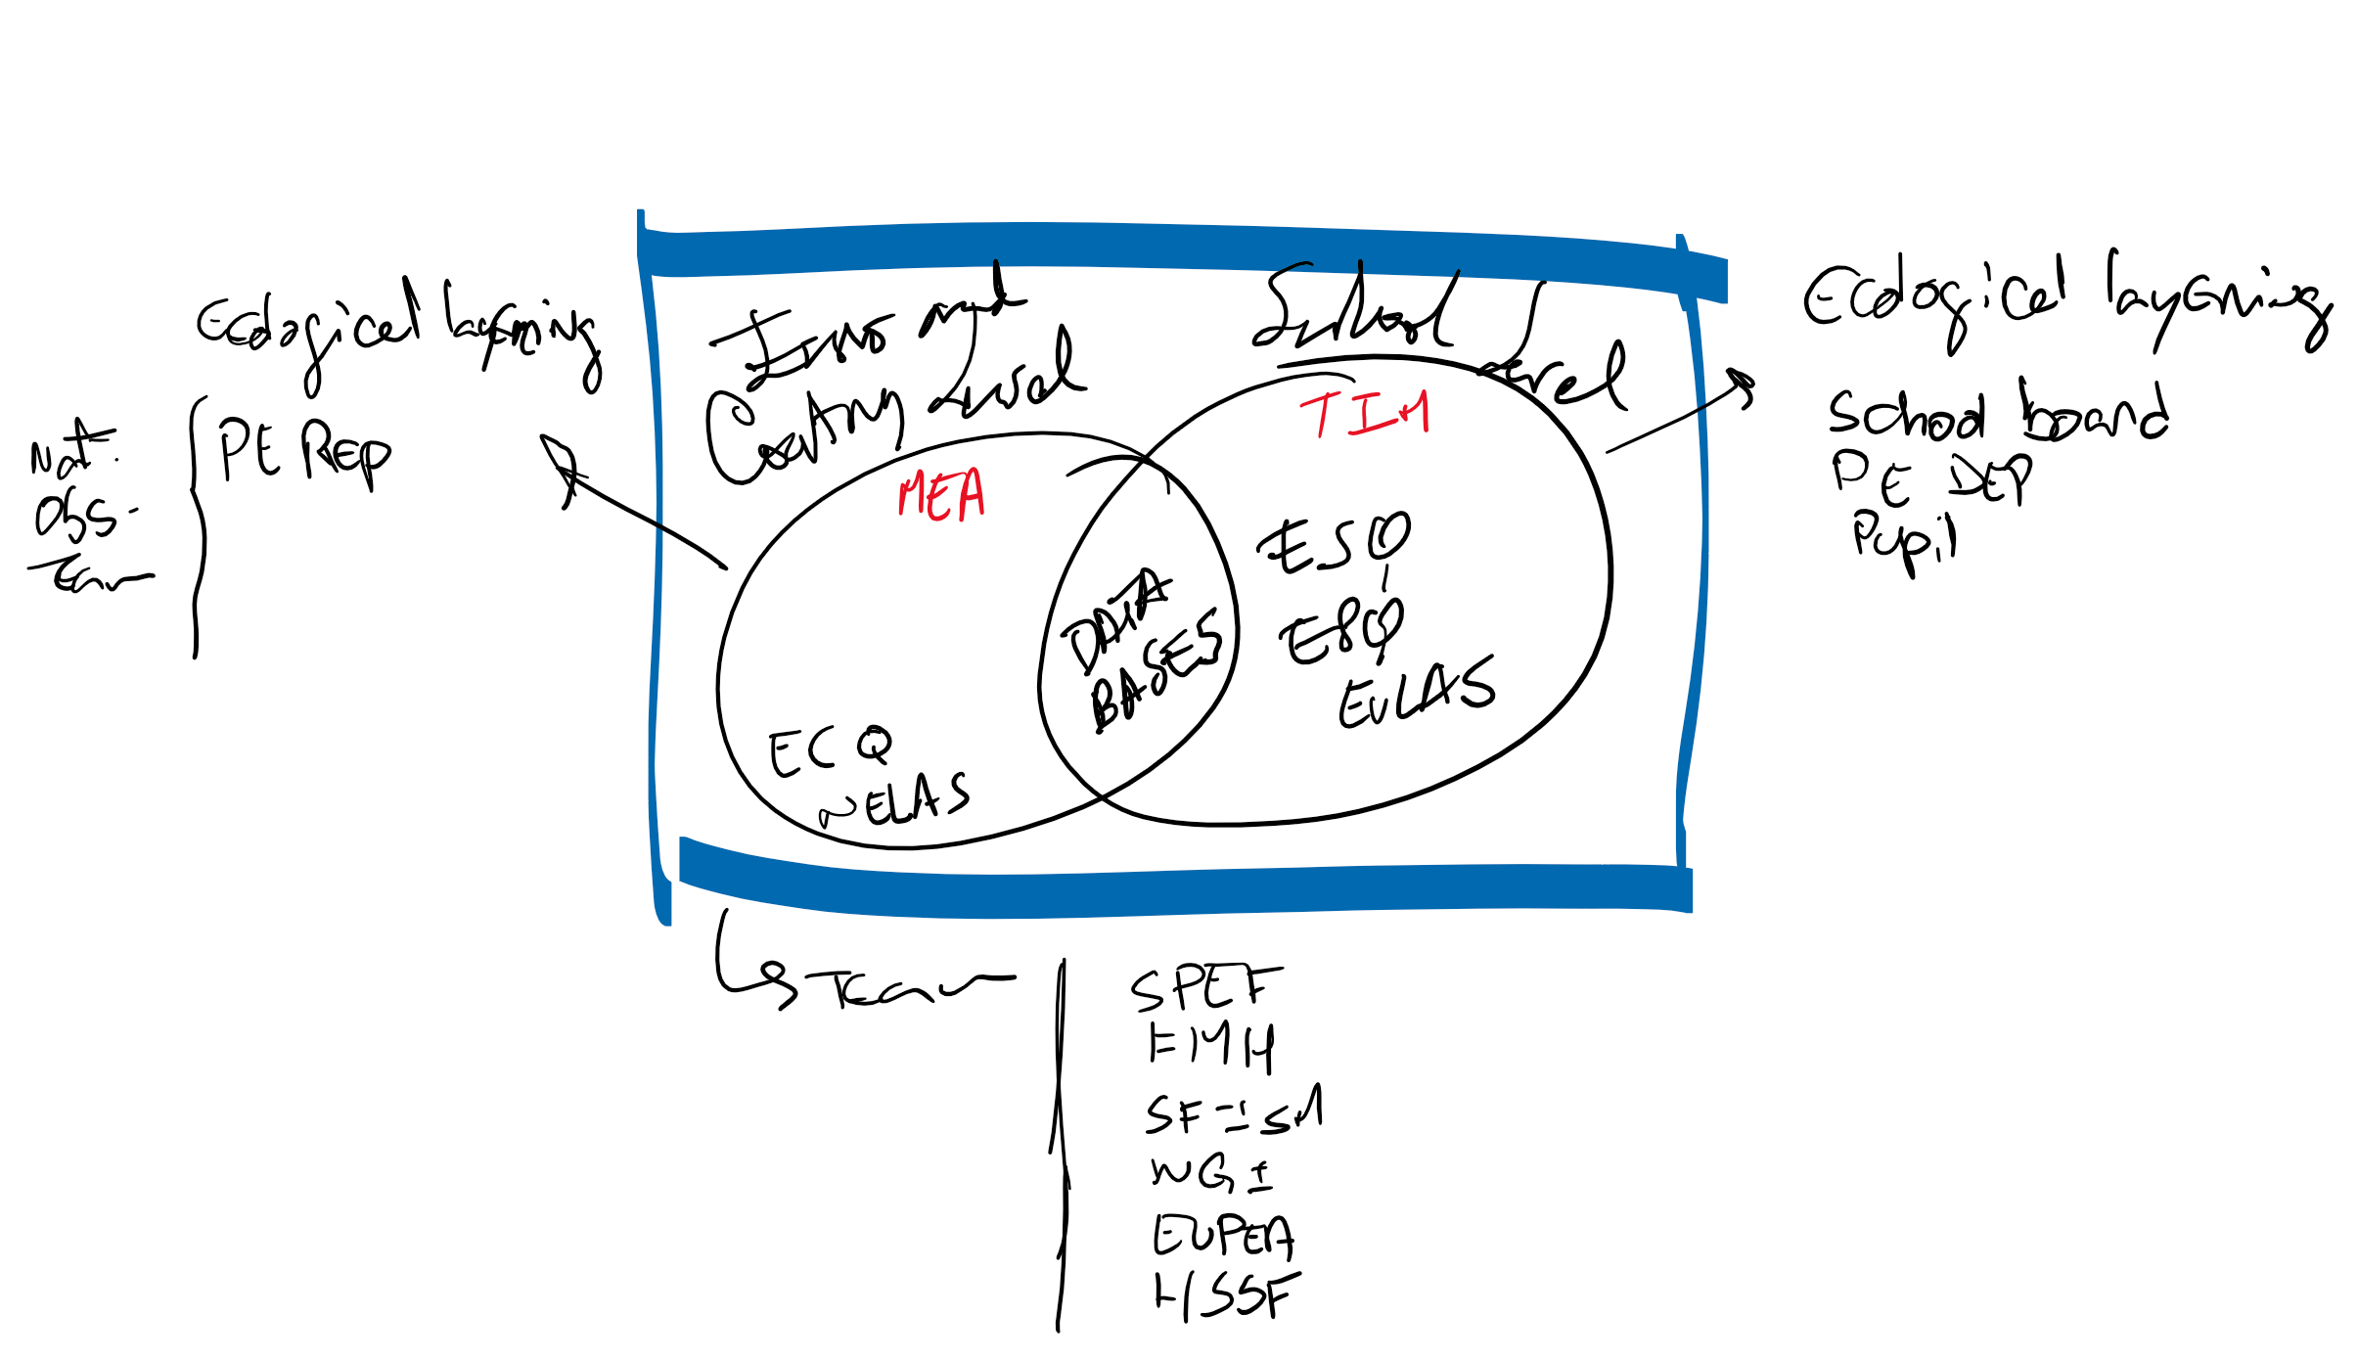
From EuPEO 2nd Transnational Project Meeting, Paris, 22-24 March 2019
MEA/TIM Decisions (1)
Agreed General Design and Principles

Slide 22
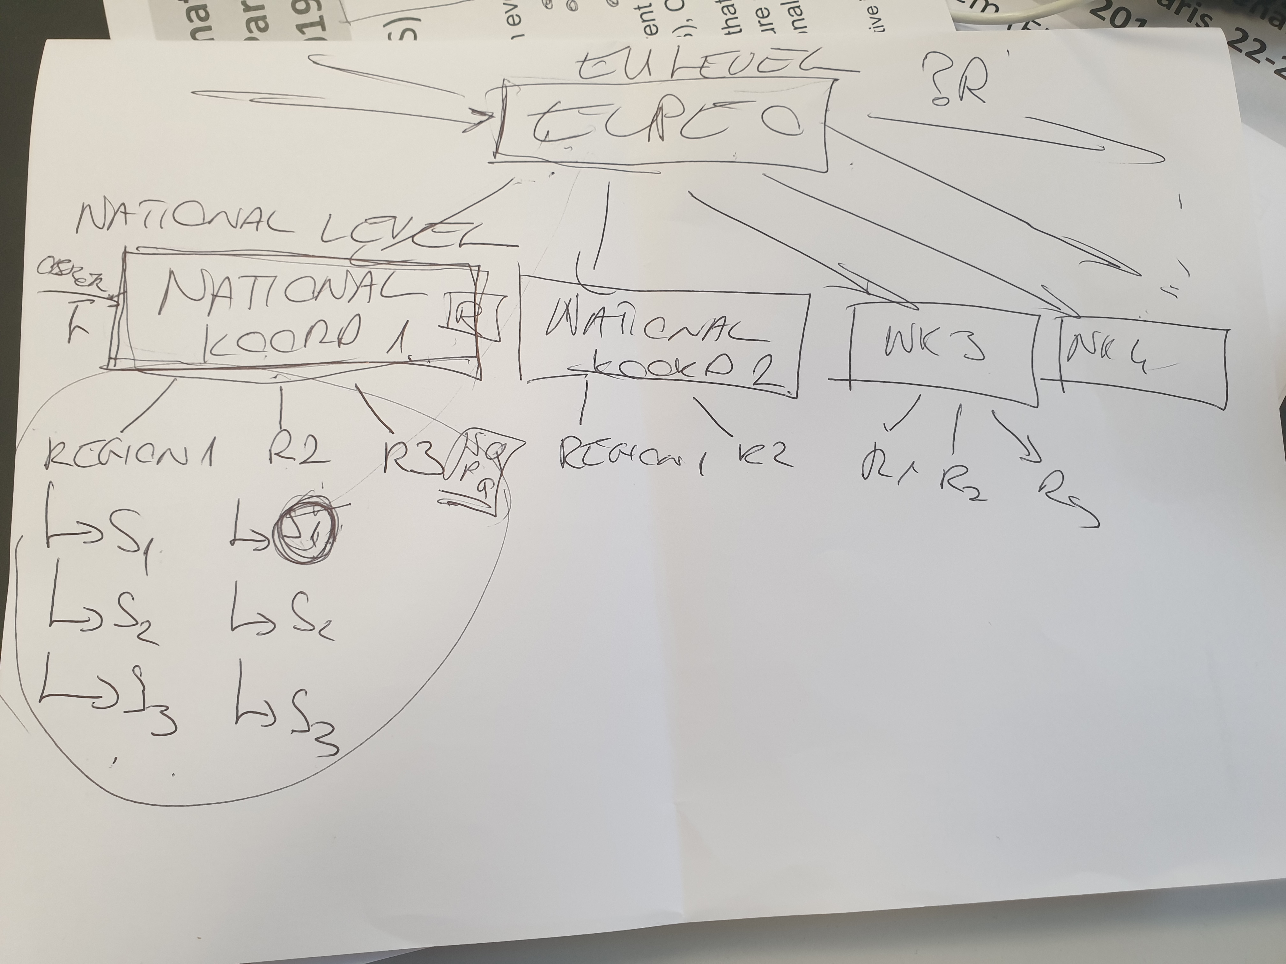
From EuPEO 2nd Transnational Project Meeting, Paris, 22-24 March 2019
MEA/TIM Decisions (2)
Structural Elements

Slide 23
From EuPEO 2nd Transnational Project Meeting, Paris, 22-24 March 2019
MEA/TIM Decisions (2)
Procedures/Organisation
  Establish what type of data and report EuPEO desires
  Create a multi-layered code design procedure to avoid use of class lists (e.g. Country Letter, Region/State Letter, School Number, Class Number, Student Number)
  Establish Evaluation indicators (e.g. time to complete, perceived value and impact of outputs, implementation structure)
  Discuss “National Observatory” certified teams as “Focal Points for PA Monitoring”
  For the pilot, the project plan will be adjusted according to the built experience and knowledge on school buy-in and burden to a minimum of 4 classes from a minimum of 2 schools (countries can collect as much data as they want)
  Consider that the implementation of MEA and TIM also includes the evaluation of the implementation structure:
    This structure is a content for 3rd TPM
    “Homework” for each partner until 3rd TPM includes the design of a business model canvas (to be sent by UCC)

Slide 24
From EuPEO 2nd Transnational Project Meeting, Paris, 22-24 March 2019
Manual for External Assessment (MEA)
will correspond to the rules for using the final platform at the national level, constituted by the ECQ and NELAS surveys and the databases from ESQ, EPQ and EuLAS.
open access methodological e-book to be integrated in the platform supported by the EuPEO webpage
it will guide the data collection/analysis processes to feed the observatory database disseminated through the EuPEO webpage
EuPEO MEA can facilitate the analysis and implementation of sport and education integrated policies to increase and promote inclusive opportunities for HEPA through QPE.

Slide 25
From EuPEO 2nd Transnational Project Meeting, Paris, 22-24 March 2019
Toolkit for Internal Monitoring (TIM)
will be composed by a set of instructions concerning the Quality Physical Education manual indicators (ESQ, EPQ, EuLAS) to be used within each school as a monitoring procedure and to inform the improvement of those indicators
open access methodological e-book
will capacitate the schools to monitoring the Health Enhancing Physical Activity recommendations directly regarding PE and SS
the results of this monitoring will allow each country to identify good examples of schools

Slide 26
From EuPEO 2nd Transnational Project Meeting, Paris, 22-24 March 2019
EuPEO Learning Assessment System (ELAS) Decisions
Agreed system composed by 3 dimensions:
  Health Related Fitness (aerobic endurance + strength)
  Physical Literacy (questionnaire on PE related cognitive, social, physical and social outcomes)
  Specialised Movement Skills (Scoring Rubric for Games, Athletics, Gymnastics to be reported by students and teachers)

Slide 27
From EuPEO 2nd Transnational Project Meeting, Paris, 22-24 March 2019
Final Outputs of the Paris Working Groups
Integration of EuPEO Questionnaires
Questionnaire Changes after Paris
EuPEO School Questionnaire (ESQ): http://inqueritos.fmh.ulisboa.pt/index.php/665996?lang=en
EuPEO Country Questionnaire (ECQ): http://inqueritos.fmh.ulisboa.pt/index.php/836448?lang=en
National External Learning Assessment (NELAS): http://inqueritos.fmh.ulisboa.pt/index.php/574826?lang=en
EuPEO Pupil Questionnaire (EPQ): http://inqueritos.fmh.ulisboa.pt/index.php/958856?lang=en

Slide 28
EuPEO
3rd Transnational Project Meeting
Ljubljana, 25-28 September 2019
Organisation strategy
Paris' subsequent work (closing of the groups´ working, proposals and remarks on it, use of the shared google drive);
Work on final MEA and TIM proposals
Grouping, Communication (emails, skypes, ….),
Workflow (planning and accomplishment of the tasks)

Slide 29
EuPEO
3rd Transnational Project Meeting
Ljubljana, 25-28 September 2019
Presentation of the Global proposal for EuPEO: MEA and TIM parts and integration
By Marcos Onofre (FMH), João Costa (SPEF), Roland Naul (WGI), Rose-Marie Repond (SFISM), Claude Scheuer and Martin Holzweg (EUPEA), Támas Csanyí (HSSF)

Slide 30
EuPEO
3rd Transnational Project Meeting
Ljubljana, 25-28 September 2019
26th September (11:00 am – 11:30 am)
Coffee-break

Slide 31
EuPEO
3rd Transnational Project Meeting
Ljubljana, 25-28 September 2019
26th September
(11:30 am – 1:00 pm)
Presentation and Discussion of the MEA proposal
By Marcos Onofre (FMH), Roland Naul (WGI), Claude Scheuer (EUPEA)

Slide 32
EuPEO
3rd Transnational Project Meeting
Ljubljana, 25-28 September 2019
26th September
(1:00 pm – 2:30pm)
Lunch

Slide 33
EuPEO
3rd Transnational Project Meeting
Ljubljana, 25-28 September 2019
26th September
(2:30 am – 7:00 pm)
Preparation of the MEA Pilot
All

Slide 34
EuPEO
3rd Transnational Project Meeting
Ljubljana, 25-28 September 2019
27th September
(9:00 am – 1:00 pm)
Presentation and Discussion of the TIM proposal
João Costa (SPEF), Rose-Marie Repond (SFISM), Martin Holzweg (EUPEA), Tamás Csanyí (HSSF)

Slide 35
EuPEO
3rd Transnational Project Meeting
Ljubljana, 25-28 September 2019
Review of Decisions for MEA
Merge ECQ and NELAS (YES)
Split in to MEA Monitoring and MEA Assessment (remain on original MEA - Assessment)
Consider who composes the sample (submit to the other partners the 4 solutions we raised during the discussion Google form:
  1) only one respondent/national PE association representative);
  2) one respondent/national association + validation by 3 other stakeolders (one research unit in higher learning of PE; one state governmental authority/focal point of monitoring PE; one individual senior expert of evaluation research in PESS);
  3) four respondents to the same entry: national association one research unit in higher learning of PE; one state governmental authority/focal point of monitoring PE; one individual senior expert of evaluation research in PESS;
  4) four respondents, one entry to each (total of four entries).
Review specific items (independent of merging) (maintain and consider the review after the pilot)

Slide 36
EuPEO
3rd Transnational Project Meeting
Ljubljana, 25-28 September 2019
Review of Decisions for MEA
Agreed inclusion criteria for NELAS to be included in the MEA
  External to School, Standardised (related to curriculum Learning Outcomes), During the compulsory Education + Implemented as mandatory or elective
During the background discussion, focus EuPEO Team presentations with references
The Manual is written in the perspective of the National EuPEO points regarding the National use
Create a package of codes for the pilot to each country, considering a minimum sample of 8 classes (2classes x 4 schools)

Slide 37
EuPEO
3rd Transnational Project Meeting
Ljubljana, 25-28 September 2019
Homework
Translations:
  2 information letters
  3 informed consents
  1 data protection policy
  MEA and TIM (when submitted)
  IO1 in Slovenian
Sending/Verification
  Timesheets
  Tertiary Reports
  IO1 Ireland
  Include the links to organised shared google drive
  Provide a medium to track the status of work by partner

Slide 38
EuPEO
3rd Transnational Project Meeting
Ljubljana, 25-28 September 2019
27th September
(2:30 am – 7:00 pm)
Preparation of the of the TIM Pilot
All

Slide 39
EuPEO
3rd Transnational Project Meeting
Ljubljana, 25-28 September 2019
Review of Decisions for TIM
EuLAS – Pupil:
  only with self-perception
  Self-perception tool is PSDQ 21 items
1 session for the pupil data collection on the EPQ and EuLAS-P
EPQ and EuLAS-P in one tool
EuLAS – Teacher
  Uses students codes
  Completes HRF and PA

Slide 40
EuPEO
3rd Transnational Project Meeting
Ljubljana, 25-28 September 2019
28th September
(9:00 am – 1:00 pm)
Review and scheduling of the general workflow
Marcos Onofre (FMH), João Costa (SPEF) & All

Slide 41
EuPEO
3rd Transnational Project Meeting
Ljubljana, 25-28 September 2019
Workflow Decisions
Timeline
Task | Deadline
Translation of Data Protection Policy, Info Letters and Informed Consents, PSDQ (see homework / google drive) | 11th Oct
Finishing IO3 and IO4 protocol Adjustments from Ljubljana Meeting Translation of MEA and TIM Digitation of MEA and TIM Verification of MEA and TIM (online tools and paper documents) | 4th Oct 18th Oct 25th Oct 1st Nov
Establish the School EuPEO Partner for the sample of the pilot stage | 1st Nov
Ensure Ethical Approvals from relevant bodies (responsibility of national teams to store the documents) | As soon as possible
EuPEO Data Collection | 4th November to 31st December

Slide 42
EuPEO
3rd Transnational Project Meeting
Ljubljana, 25-28 September 2019
Munster Meeting Preparation
Proposal of Dates
  A) 25th to 28th March (preference)
  B) 22nd to 25th March
Organisation
  Airport for Arrival - FMO
  More connection flights from Frankfurt and from Munich
  Connection trains from Dusseldorf and Cologne
  Possibility of connecting flight through Copenhagen and Viena
  Roland will send one ppt with a presentation and relevant details
  Deadline to vote the dates – Mid-October
  Sending of requested agenda items to the coordination by December
  Sending to partners the general outline of agenda by January

