Slide 1












4th EuPEO Transnational Project Meeting
On-line (replacing Munster postponed to Magglingen),
15-16 June 2020

Slide 2

EuPEO 4rd Transnational Project Meeting
On-line (replacing Munster postponed to Magglingen), 15-16 June 2020
EuPEO Project, Part 2, Work Package 3, Activity 25
Meeting number | 4
Dates and venue (adjustments) | “March 2020, Munster (WGI)”, postponed Magglighen (SFISM) to: 1st part meeting on-line in 26th March, 2nd part meeting on-line on the 15th and 16th June
Description of the meeting (adjustments | “Four days workshop for the global evaluation and adjustment of the MEA and TIM original proposals and definition of the final versions”, replaced by: 1st part: one on-line meeting to define the structure and content of the MSE 2nd part; focused on the original purpose

Slide 3
EuPEO 4th Transnational Project Meeting
On-line (replacing Munster postponed to Magglingen), 15-16 June 2020
Item 1. Coordination Greetings 9h00m-9h30m
Welcome the Partners (SFISM, FMH, SPEF) Introduce the Meeting Agenda & Relevant general information (FMH and SPEF)

Slide 4
EuPEO 4th Transnational Project Meeting
On-line (replacing Munster postponed to Magglingen), 15-16 June 2020
Meeting Organisation Items
Partners apologies and participation procedures during the on-line meeting Information about video-recording Short comment on different countries’ confinement and its’ implications for the EuPEO (contingency for September meeting and National MSE) SNPEA’s situation in the EuPEO

Slide 5
EuPEO 4th Transnational Project Meeting
On-line (replacing Munster postponed to Magglingen), 15-16 June 2020
AGENDA - 15th June Online Meeting (Morning: 9 am to 12am) All Partners
Time/Activity | Session Aims (Responsible)
Item 1. Coordination Greetings 9h00m-9h30m | Welcome the Partners (SFISM, FMH, SPEF) Introduce the Meeting Agenda & Relevant general information (FMH and SPEF)
Item 2. Administrative and Financial Report 9h30m-10h30m | Update Partners on the Administrative and Financial Aspects (FMH – Andreia Sousa)
Coffee Break (10h30m-10h50m)
Item 3. Coordination Summary Report 10h50m-11h20m | Coordination Summary Report since March 26th (FMH and SPEF)
Item 4. EuPEO Pilot National Review (Process and Results) – Part 1 11h20m-12h10m | National Presentations of the Pilot Results (15min for presentation and questions) (National Partners: France; Slovenia; Czech Republic)
Lunch Break (12h10m-14h00m)

Slide 6
EuPEO 4th Transnational Project Meeting
On-line (replacing Munster postponed to Magglingen), 15-16 June 2020
AGENDA - 15th June Online Meeting (Afternoon: 2pm to 5pm) All Partners
Time/Activity | Session Aims (Responsible) | Brief Report
Item 4. EuPEO Pilot National and European Review (Process and Results) – Part 2 14h00m-15h20m | National Presentations of the Pilot Results (15min for presentation and questions) (National Partners and EUPEA: Germany; Switzerland; Ireland; Portugal; EUPEA)
Coffee Break (15h20 -15h40)
Item 5. EuPEO Pilot Coordination (Process Evaluation Review) 15h40m-17h00m | Coordination Pilot Review (FMH and SPEF) | FMH – Data Input and Treatment Coordination Overall Review (Discussion of the EuPEO Pilot Evaluation Documents – focus on yellow highlighted points)
(17h00m-17h30m) Administrative and Financial issues bilateral discussions (by appointment with Andreia Sousa, 15min/slots)

Slide 7
EuPEO 4th Transnational Project Meeting
On-line (replacing Munster postponed to Magglingen), 15-16 June 2020
16th June Online Meeting (Morning: 9 am to 12am) All Partners
Time/Activity | Session Aims (Responsible) | Brief Report
Item 6. EuPEO IO3 - MEA Evaluation 9h00m-10h50m | EuPEO Team Evaluation Review of MEA (All Partners) | MEA Evaluation: Review and Discussion of Proposed Changes to EuPEO IO3 – MEA MEA QPE Framework Alignment
Coffee Break (10h50m - 11h10m)
Item 7. EuPEO IO4 – TIM Evaluation – Part 1 11h10m-12h10m | EuPEO Team Evaluation Review of TIM (All Partners) | TIM Evaluation: Review and Discussion of Proposed Changes to EuPEO IO4 – TIM
Lunch Break (12h10m - 14h00m)

Slide 8
EuPEO 4th Transnational Project Meeting
On-line (replacing Munster postponed to Magglingen), 15-16 June 2020
16th June Online Meeting (Afternoon: 2pm to 5pm) All Partners
Time/Activity | Session Aims (Responsible) | Brief Report
Item 7. EuPEO IO4 – TIM Evaluation – Part 2 14h00m-15h00m | EuPEO Team Evaluation Review of TIM (All Partners) | TIM Evaluation: Review and Discussion of Proposed Changes to EuPEO IO4 – TIM TIM QPE Framework Alignment
Coffee Break (15h00m - 15h20m)
Item 8. EuPEO Next Stages 15h20m-16h40m | National MSE Preparation Updates (All Partners). EuPEO 5th TPM Munster Meeting (Germany and Coordination). European MSE Preparation Updates and EuPEO IO5 (Final Report) timeline discussion. (All Partners). IO5 – Final EuPEO Report (FMH/SPEF/EUPEA)
Item 9. EuPEO Feedback and Dissemination 16h40m-17h00m | Clarification of EuPEO Feedback Process to Schools EuPEO Special Issue proposal to the European Physical Education Review (FMH and SPEF)
( 17h00m-17h30m) Administrative and Financial issues bilateral discussions (by appointment, 15min/slots)

Slide 9
EuPEO 4th Transnational Project Meeting
On-line (replacing Munster postponed to Magglingen), 15-16 June 2020
Item 2. Administrative and Financial Report 9h30m-10h30m
Update Partners on the Administrative and Financial Aspects (FMH – Andreia Sousa)

Slide 10
EuPEO 4th Transnational Project Meeting
On-line (replacing Munster postponed to Magglingen), 15-16 June 2020
Coffee Break (10h30m-10h50m)

Slide 11
EuPEO 4th Transnational Project Meeting
On-line (replacing Munster postponed to Magglingen), 15-16 June 2020
Item 3. Coordination Summary Report 10h50m-11h20m
Coordination Summary Report since March 26th (FMH and SPEF)

Slide 12
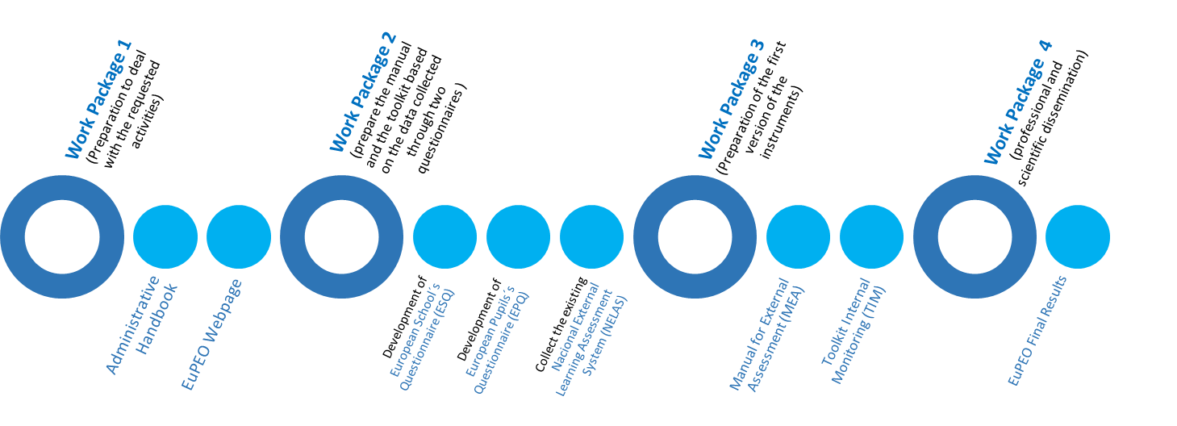
EuPEO 4th Transnational Project Meeting
On-line (replacing Munster postponed to Magglingen), 15-16 June 2020
EuPEO: From where we started and where we are.

Slide 13
EuPEO 4th Transnational Project Meeting
On-line (replacing Munster postponed to Magglingen), 15-16 June 2020
EuPEO: From where did we start and what was our journey so far?
Short review of the pages 33 to 41 of the application “Project Description”
From to | Work Package 1 Work Package 2 Work Package 3 Work Package 4 | EuPEO Administrative Handbook, E-book EuPEO Webpage IO1 - National Intermediate Reports, E-book IO2 - European Intermediate Report, E-book IO3 - EuPEO Manual for External Assessment (MEA), E-book IO4 - EuPEO Toolkit for Internal Monitoring (TIM), E-book IO5 - EuPEO Final Report, E-book

Slide 14
EuPEO 4th Transnational Project Meeting
On-line (replacing Munster postponed to Magglingen), 15-16 June 2020
Work Since March 26th
Partners’ closing the Pilot Data base treatment for EULAS-T and closing Pilot Pilot evaluation Preliminary data analysis

Slide 15
EuPEO 4th Transnational Project Meeting
On-line (replacing Munster postponed to Magglingen), 15-16 June 2020
Item 4. EuPEO Pilot National Review (Process and Results) – Part 1 11h20m-12h10m
National Presentations of the Pilot Results (15min for presentation and questions) France Slovenia Czech Republic

Slide 16
EuPEO 4th Transnational Project Meeting
On-line (replacing Munster postponed to Magglingen), 15-16 June 2020
Lunch Break (12h10m-14h00m)

Slide 17
EuPEO 4th Transnational Project Meeting
On-line (replacing Munster postponed to Magglingen), 15-16 June 2020
Item 4. EuPEO Pilot National and European Review (Process and Results) – Part 2 14h00m-16h40m
National and European Presentations of the Pilot Results (15min for presentation and questions) Germany Switzerland Ireland Portugal EUPEA

Slide 18
EuPEO 4th Transnational Project Meeting
On-line (replacing Munster postponed to Magglingen), 15-16 June 2020
Administrative and Financial issues bilateral discussions (17h00m-17h30m) (by appointment with Andreia Sousa, 15min/slots)

Slide 19
EuPEO 4th Transnational Project Meeting
On-line (replacing Munster postponed to Magglingen), 15-16 June 2020
Item 5. EuPEO Pilot Coordination (Process Evaluation Review) 9h00m-9h20m
Coordination Pilot Review (FMH and SPEF)

Slide 20
EuPEO 4th Transnational Project Meeting
On-line (replacing Munster postponed to Magglingen), 15-16 June 2020
A Critical Stage of the Pilot Evaluation (EULAS-T)
FMH data input and treatment Pilot evaluation word document

Slide 21


EuLAS-T challenges on data treatment
Dora Carolo¹, João Martins¹, Marcos Onofre¹, João Costa², Nuno Ferro², Ana Quitério¹, Maria Martins¹
Faculdade de Motricidade Humana (FMH-UL)¹
Sociedade Portuguesa de Educação Física (SPEF)²
Notes:
Opening slide

Slide 22
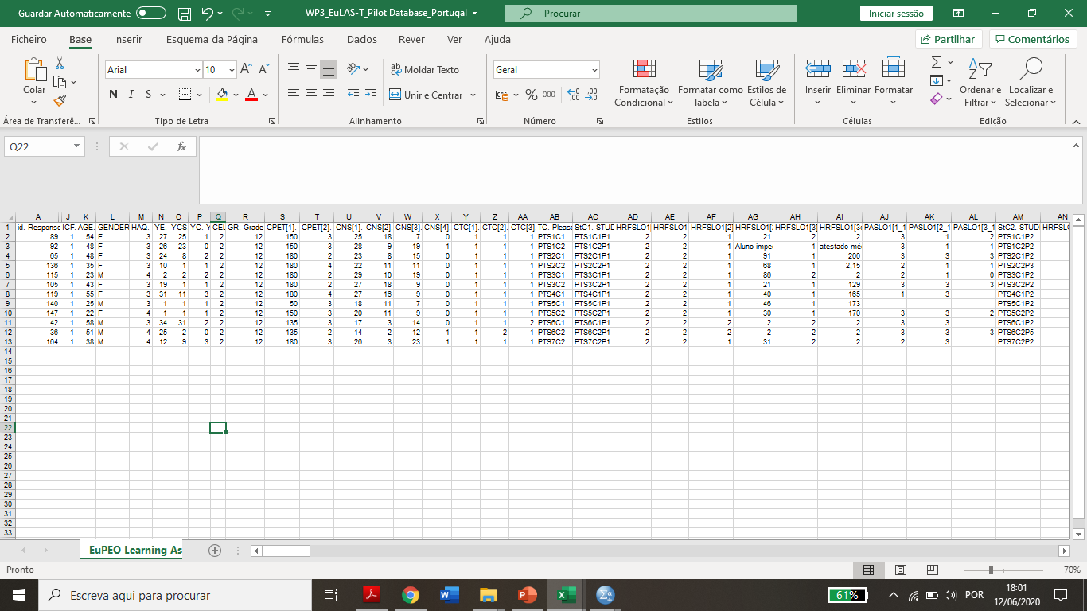
EuLAS-T original structure: problems
A teacher who has a class with few students, must click the "next" button several times until being able to submit the data.
Each line corresponds to the data of all students in an identified class.
In the database of France and Slovenia, we identified difficulties regarding data input.
Some teachers tried to input data from more than one class in the same questionnaire (entry).
Notes:
Presentation slide 2 – with EuPEO logo at the top

Slide 23
Students' age and gender were not asked. We needed this information to estimate the VO₂ peak. We had to copy this information from the EPQ with the consequence of losing valid entries in the VO₂ peak.
Shuttle Run test [Vo2peak=0,353(LAP)-1,12(AGE)+45,619]
Ljubljana meeting: decision on common reference tables for Physical fitness. Absence of reference tables for the different EuLAS-T physical fitness tests (shuttle, mile, horizontal jump).
Some countries consider different units and tests while inputting data (e.g. presenting levels or velocity in shuttle run; 8km test). We had to perform data conversion considering national references.
Notes:
Presentation slide 2 – with EuPEO logo at the top

Slide 24
New variables had to be created.
New variables
Student demographics | Mile test (for time conversion) | Shuttle Run Test (for Vo2peak) | Fitness Zone
Age Gender (copied from EPQ) | MileTime_Original MileTime_Minutes_Partial MileTime_MinutesToSeconds MileTime_Seconds_Partial MileTime_Seconds | 0,353*LAP 1,12*age Vo2peak | Aerobic Fitness Zone (new syntax file had to be created)
Notes:
Presentation slide 2 – with EuPEO logo at the top

Slide 25
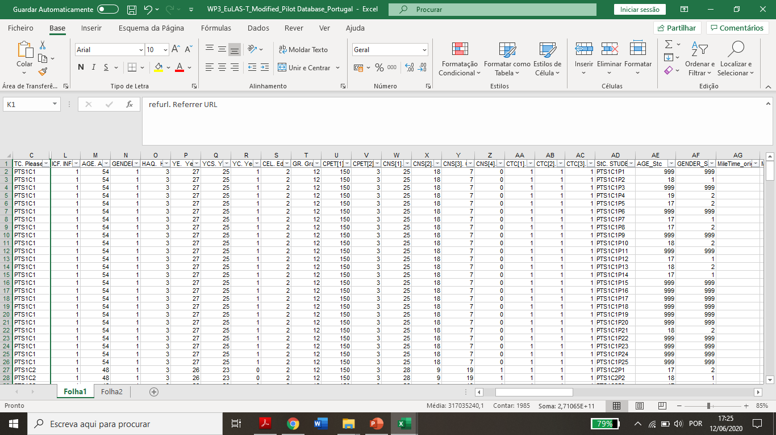
EuLAS-T redefined structure
PTS1C1 class
PTS1C1P1 – P25 at the same column
The database became organized by class and student in each line.
New problem: Repetition of entries on Teacher´s demographists.
Solution: divide the database in two, A- Teacher´s demographics and B- EuLAS-T
Notes:
Presentation slide 2 – with EuPEO logo at the top

Slide 26
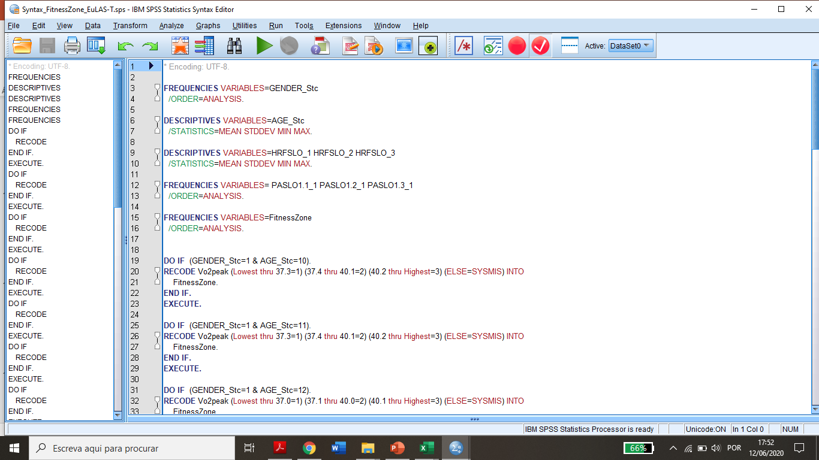
Two new EuLAS-T Syntax Files: “ EuLAS-T fitness zone” and “teacher demographics.”
Notes:
Presentation slide 2 – with EuPEO logo at the top

Slide 27
EuLAS-T Key Recommendations and Possible Decisions
Notes:
Presentation slide 2 – with EuPEO logo at the top

Slide 28
Key Recommendations
1) Separate teachers’ sociodemographic data from data relating to students (two questionnaires). Option 1: As for the data regarding physical fitness and descriptors in physical activities, the teacher must submit information for each student by clicking on the questionnaire link for each new submission. Option 2: build an Excel sheet in which teachers can directly enter the data of each student (one student per line). 2) Find reference tables for each physical fitness test that are common to each country or admit that each country will be responsible for processing data according to its own national references. 3) Make the descriptors available for evaluating the area of physical activities in the TIM annex and highlight their use for assessing students' learning. 4) Make the registration sheet available in the TIM annex. Paper and Excel version? 5) Find an equation to be applied in cases where the school only applies the mile as an aerobic endurance test (rare in the pilot); 6) Change the structure of the questionnaire so that the teacher inserts all the necessary data for the calculation of the estimated VO2max (gender and age of each student). 7) The data should be made available to the teachers. Put the results in perspective at European and national level.
Notes:
Presentation slide 2 – with EuPEO logo at the top

Slide 29
Possible decisions to make
Reframe the process in MEA and TIM as follows: 1. MEA - In the ECQ, curriculum flexibility/assessment request the participant to upload the reference HRF criterion tables in English – this allows to identify and collate all national reference tables and identify the countries without reference tables. 2. TIM - Align the EuLAS-T survey for the HRF tests accordingly. EuLAS-T will now request the teacher to input student´s gender and age. (upload excel sheet) The proposed solution for data collection, which also serves as immediate output, is the creation of an automated excel sheet Split EuLAS-T in part A (teacher demographics , 1 time completion) and part B (student learning data). 3. MEA – National team will calculate align the test results to the HRF criteria (national or Fitnessgram, depending on what is available in the country) so that the national and European reports refer to the agreed categories (Aerobic Endurance and Explosive Strength) according to the HRF criterion as a common standard.
Notes:
Presentation slide 2 – with EuPEO logo at the top

Slide 30
EuPEO 4th Transnational Project Meeting
On-line (replacing Munster postponed to Magglingen), 15-16 June 2020
Item 6. EuPEO IO3 - MEA Evaluation 9h20m-10h50m
EuPEO Team Evaluation Review of MEA (All Partners) MEA Evaluation: Review and Discussion of Proposed Changes to EuPEO IO3 – MEA MEA QPE Framework Alignment

Slide 31
EuPEO 4rd Transnational Project Meeting
On-line (replacing Munster postponed to Magglingen), 15-16 June 2020
Item 6. EuPEO IO3 - MEA Evaluation Review and Discussion of Proposed Changes to EuPEO IO3 – MEA
EuPEO MEA (Word document yellow highlights) According to EuPEO Pilot Evaluation – Recommendations

Slide 32
EuPEO 4rd Transnational Project Meeting
On-line (replacing Munster postponed to Magglingen), 15-16 June 2020
Item 6. EuPEO IO3 - MEA Evaluation Review and Discussion of Proposed Changes to EuPEO IO3 – MEA
MEA QPE Framework Alignment

Slide 33
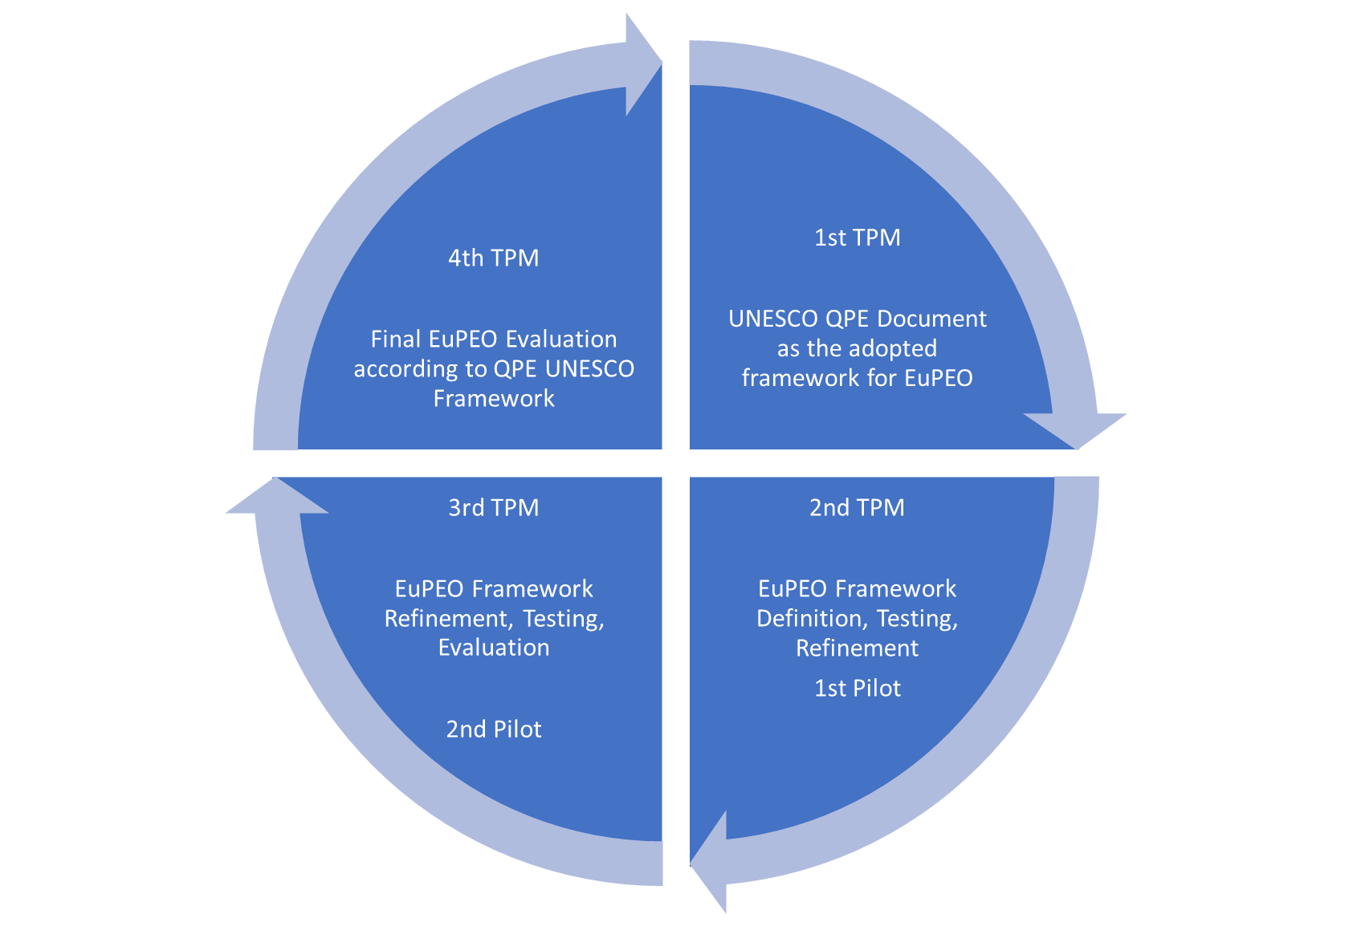
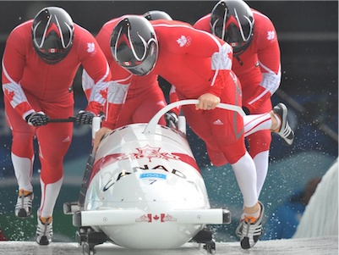



EuPEO 4rd Transnational Project Meeting
On-line (replacing Munster postponed to Magglingen), 15-16 June 2020
Development of EuPEO’s Theoretical, Construct, and Ecological Validity – Aligned to UNESCO QPE Framework

Slide 34
EuPEO 4rd Transnational Project Meeting
On-line (replacing Munster postponed to Magglingen), 15-16 June 2020
QPE Dimension (UNESCO/EuPEO) | UNESCO View | EuPEO Importance for System-Level Action | EuPEO MEA Alignment with QPE
PE National Policy | Focus on inclusion of teaching for learning opportunities “to mainstream the principles and practice of inclusive methodologies within physical education to students, parents, and members of the wider community.” (P.32) “Policy implementation, and the delivery of QPE, should be supported by clear systems for monitoring and quality assurance, accompanied by support systems that assist teachers and schools in developing strengths and addressing weaknesses.” (p.46) | Ensuring QPE opportunities for all children and youth, aligning all QPE dimensions in a national policy, based on local, national and european QPE monitoring evidence and cross-sector and cross-stakeholder collaboration. Leverage advocacy towards an explicit inclusion of QPE enactment and impact as part of educational policy (in a standalone or, preferably, integrated perspective). | MEA includes this dimension in the ECQ as a national representation of QPE explicit policy and associated components.

Slide 35
EuPEO 4rd Transnational Project Meeting
On-line (replacing Munster postponed to Magglingen), 15-16 June 2020
QPE Dimension (UNESCO/EuPEO) | UNESCO View | EuPEO Importance for System-Level Action | EuPEO MEA Alignment with QPE
Curriculum Flexibility | “QPE provides a wide range of learning contexts and environments which require resource and creativity from learners, as well as the ability to work both independently and collaboratively.” (p.42) | Ensuring an holistic, integrated and flexible view of curriculum focusing on Physical Education, School Sports and Other Forms of Physical Activity as structured and protected opportunities for meaningful School-based Physical Activity. Support multi-stakeholder evidence-informed discussions and decision-making on curriculum development and PE positioning in national Education. Based on TIM integration, identify and act upon QPE good practices for dissemination and scaling, and sites and settings in need of direct support for improvement. | MEA includes this dimension in the ECQ as a national representation of the curriculum (PE, SS, OFPA) in its multiple components (subject designation, contents, time, school and external Assessment – NELAS – pedagogical principles). MEA includes this dimension as an aggregated view of local realities through the TIM results on the integration of data from ESQ, EPQ, and EuLAS-T for an horizontal view of QPE policy enactment and impact at school, national, and european levels.

Slide 36
EuPEO 4rd Transnational Project Meeting
On-line (replacing Munster postponed to Magglingen), 15-16 June 2020
QPE Dimension (UNESCO/EuPEO) | UNESCO View | EuPEO Importance for System-Level Action | EuPEO MEA Alignment with QPE
Teacher Education | “As the provision of QPE depends on well-qualified educators, responsible authorities should undertake punctual reviews of systems of QPETE as a policy priority.” (p.50) | Ensuring that QPE is directly provided by qualified specialists in PE capable of and accountable for their professional development throughout the teaching careers. Identify relationships between QPE impact and the specialists to act upon professional development issues affecting PE specialists. | MEA includes this dimension in the ECQ as a national representation of the QPETE continuum (initial, induction, and continuous) with regards to its PE specialism qualification level and pathway, professional development organisation, structures, and provision.
Teacher Workforce |  | Ensuring a balanced demographic representation of the teacher workforce, at least in terms of age and gender, but also relative to other sociodemographic factors as culturally relevant. Identify the presence and update of data on the PE teacher workforce towards identifying and acting upon absence or outdate data, and critically about imbalances that compromise the QPE sustainability. | MEA includes this dimension in the ECQ as a national representation of the total PE specialists and their sociodemographic distribution. MEA includes this dimension as an aggregated view of local realities through the TIM data from the ESQ for an horizontal view of QPE impact at school, national, and european levels relative to the teacher workforce.

Slide 37
EuPEO 4rd Transnational Project Meeting
On-line (replacing Munster postponed to Magglingen), 15-16 June 2020
QPE Dimension (UNESCO/EuPEO) | UNESCO View | EuPEO Importance for System-Level Action | EuPEO MEA Alignment with QPE
Facilities, Equipments and Resources | “The provision of QPE requires material resources, and appropriate technical support, to ensure access to physical education for all pupils, including those with disabilities, and those with specific religious requirements.” (p.54) | Ensuring appropriate level and maintenance of structural resources to fully and meaningfully develop the PE curriculum contents, objectives, principles and aims. Identify and act upon compromised PE curriculum areas and objectives, especially based on pupil learning achievement in PE, as related to insuficiencies or deficiencies of resources at school, national or european level. | MEA includes this dimension as an aggregated view of local realities through the TIM data from the ESQ for an horizontal view of QPE impact at school, national, and european levels relative to the overall resources.

Slide 38
EuPEO 4rd Transnational Project Meeting
On-line (replacing Munster postponed to Magglingen), 15-16 June 2020
QPE Dimension (UNESCO/EuPEO) | UNESCO View | EuPEO Importance for System-Level Action | EuPEO MEA Alignment with QPE
Community Partnerships | “When considering the role of physical education in promoting engagement in healthy, active lifestyles through the life course, the development of partnerships – between schools and community-based sports organizations and clubs – is essential to accommodate broader life-long educational outcomes, including health and well-being, as well as personal and social development.” (p.44) | Maping the level, types and objectives with which schools engage and sustain community partnerships to support or improve their QPE with regards to curriculum, education, workforce and overall resources. Inform and support cross-stakeholder dialogue and collaboration for QPE in addressing areas that support pupil learning achievement in PE and other school-based PA opportunities. | MEA includes this dimension as an aggregated view of local realities through the TIM data from the ESQ for an horizontal view of QPE impact at school, national, and european levels relative to the public and private partnerships and their respective importance to support QPE.

Slide 39
EuPEO 4th Transnational Project Meeting
On-line (replacing Munster postponed to Magglingen), 15-16 June 2020
Coffee Break (10h50m - 11h10m)

Slide 40
EuPEO 4th Transnational Project Meeting
On-line (replacing Munster postponed to Magglingen), 15-16 June 2020
Item 7. EuPEO IO4 – TIM Evaluation – Part 1 11h10m-12h10m
EuPEO Team Evaluation Review of TIM (All Partners) TIM Evaluation: Review and Discussion of Proposed Changes to EuPEO IO4 – TIM TIM QPE Framework Alignment

Slide 41
EuPEO 4rd Transnational Project Meeting
On-line (replacing Munster postponed to Magglingen), 15-16 June 2020
Item 6. EuPEO IO4 – TIM Evaluation Review and Discussion of Proposed Changes to EuPEO IO4 – TIM
EuPEO TIM (Word document yellow highlights) According to EuPEO Pilot Evaluation – Recommendations

Slide 42
EuPEO 4th Transnational Project Meeting
On-line (replacing Munster postponed to Magglingen), 15-16 June 2020
Lunch Break (12h10m - 14h00m)

Slide 43
EuPEO 4th Transnational Project Meeting
On-line (replacing Munster postponed to Magglingen), 15-16 June 2020
Item 7. EuPEO IO4 – TIM Evaluation – Part 2 14h00m-15h00m
EuPEO Team Evaluation Review of TIM (All Partners) TIM Evaluation: Review and Discussion of Proposed Changes to EuPEO IO4 – TIM TIM QPE Framework Alignment

Slide 44
EuPEO 4rd Transnational Project Meeting
On-line (replacing Munster postponed to Magglingen), 15-16 June 2020
Item 6. EuPEO IO3 - MEA Evaluation Review and Discussion of Proposed Changes to EuPEO IO4 – TIM
TIM QPE Framework Alignment

Slide 45
EuPEO 4rd Transnational Project Meeting
On-line (replacing Munster postponed to Magglingen), 15-16 June 2020
QPE Dimension (UNESCO/EuPEO) | UNESCO View | EuPEO Importance for School-Level Action | EuPEO TIM Alignment with QPE
Curriculum Flexibility | “QPE provides a wide range of learning contexts and environments which require resource and creativity from learners, as well as the ability to work both independently and collaboratively.” (p.42) | Ensuring an holistic, integrated and flexible view of curriculum focusing on Physical Education, School Sports and Other Forms of Physical Activity as structured and protected opportunities for meaningful school-based Physical Activity. Support school-level data collection and curation for evidence-informed discussions and decision-making on curriculum development. Support school-level analysis of needs of student learning achievement and curriculum development, considering the school organisation, the students views on PE curriculum, teaching and assessment, and their learning outcomes across diferent sociodemographic cohorts and curriculum contents. | TIM includes this dimension across the ESQ, EPQ, and EuLAS-T, providing structured data on the student, class, teacher and School for PE, as well as information on student participation and perception in SS and OFPA.

Slide 46
EuPEO 4rd Transnational Project Meeting
On-line (replacing Munster postponed to Magglingen), 15-16 June 2020
QPE Dimension (UNESCO/EuPEO) | UNESCO View | EuPEO Importance for School-Level Action | EuPEO TIM Alignment with QPE
Teacher Workforce | “As the provision of QPE depends on well-qualified educators, responsible authorities should undertake punctual reviews of systems of QPETE as a policy priority.” (p.50) | Ensuring a balanced demographic representation of the teacher workforce, at least in terms of age and gender, but also relative to other sociodemographic factors as culturally relevant. Identify the presence and update of data on the PE teacher workforce towards identifying and acting upon absence or outdate data, and critically about imbalances that compromise the QPE sustainability. | TIM includes this dimension in the ESQ for an horizontal view of QPE impact at level relative to the teacher workforce sociodemographics and workload.

Slide 47
EuPEO 4rd Transnational Project Meeting
On-line (replacing Munster postponed to Magglingen), 15-16 June 2020
QPE Dimension (UNESCO/EuPEO) | UNESCO View | EuPEO Importance for School-Level Action | EuPEO TIM Alignment with QPE
Facilities, Equipments and Resources | “The provision of QPE requires material resources, and appropriate technical support, to ensure access to physical education for all pupils, including those with disabilities, and those with specific religious requirements.” (p.54) | Ensuring appropriate level and maintenance of structural resources to fully and meaningfully develop the PE curriculum contents, objectives, principles and aims. Identify and act upon compromised PE curriculum areas and objectives, especially based on pupil learning achievement in PE, as related to insuficiencies or deficiencies of resources at School level. | TIM includes this dimension in the ESQ for an horizontal view of QPE impact at School level relative to the overall resources considering those that are owned and those that are outsourced considering the opportunity to deliver the full PE curriculum.

Slide 48
EuPEO 4rd Transnational Project Meeting
On-line (replacing Munster postponed to Magglingen), 15-16 June 2020
QPE Dimension (UNESCO/EuPEO) | UNESCO View | EuPEO Importance for School-Level Action | EuPEO TIM Alignment with QPE
Community Partnerships | “When considering the role of physical education in promoting engagement in healthy, active lifestyles through the life course, the development of partnerships – between schools and community-based sports organizations and clubs – is essential to accommodate broader life-long educational outcomes, including health and well-being, as well as personal and social development.” (p.44) | Maping the level, types and objectives with which schools engage and sustain community partnerships to support or improve their QPE with regards to curriculum, education, workforce and overall resources. Inform and support cross-stakeholder dialogue and collaboration for QPE in addressing areas that support pupil learning achievement in PE and other school-based PA opportunities. | TIM includes this dimension in ESQ for an horizontal view of QPE impact at School level relative to the public and private partnerships and their respective importance to support QPE.

Slide 49
EuPEO 4rd Transnational Project Meeting
On-line (replacing Munster postponed to Magglingen), 15-16 June 2020
EuPEO Reporting Questions “Chain of Evidence” Principle: from micro to macro / from individual to systemic
What learning do students get from PE?
What is the amount and nature of PA opportunities that students get in schools?
How do students experience school-based PA?
How is the teaching workforce organised in schools towards supporting PA for students?
What partnerships do schools engage with to support PA for students?
To what extent is PE structured in Educational Policy?

Slide 50
EuPEO 4rd Transnational Project Meeting
On-line (replacing Munster postponed to Magglingen), 15-16 June 2020
Reporting Question | EuPEO Framework |  | EuPEO Tools
What learning do students get from PE? | Curriculum Flexibility PE Learning Outcomes | Physical-Self Perception Physical Activities Health-Related Fitness | EuLAS-P EuLAS-T ECQ-NELAS
What is the amount and nature of PA opportunities that students get in schools? | Curriculum Flexibility PA Opportunities (PE, SS, OFPA) | Participation (Time/Frequency) Content | EPQ ESQ ECQ
How do students experience school-based PA? | Curriculum Flexibility PA Experiences Facilities, Equipment and Resources | Pedagogical Principles Assessment Value Satisfaction Diversity / PE Curricular Flexibility Access Maintenance | EPQ ESQ ECQ ESQ
How is the teaching workforce organised in schools towards supporting PA for students? | Teacher Workforce Teacher Education | PE Teachers Demographics Teaching Workload Head of PE Roles ITE Induction CPD | ESQ EPQ ECQ ECQ
What partnerships do schools engage with to support PA for students? | Community Partnerships | Public vs Private Partnership Focus Importance | ESQ
To what extent is PE prioritised in Educational Policy? | PE National Policy |  | ECQ

Slide 51
EuPEO 4th Transnational Project Meeting
On-line (replacing Munster postponed to Magglingen), 15-16 June 2020
Coffee Break (15h00m - 15h20m)

Slide 52
EuPEO 4th Transnational Project Meeting
On-line (replacing Munster postponed to Magglingen), 15-16 June 2020
Item 8. EuPEO Next Stages 15h20m-16h40m
National MSE Preparation Updates (All Partners). EuPEO 5th TPM Munster Meeting (Germany and Coordination). European MSE Preparation Updates and EuPEO IO5 (Final Report) timeline discussion. (All Partners). IO5 – EuPEO Final Report

Slide 53
EuPEO 4th Transnational Project Meeting
On-line (replacing Munster postponed to Magglingen), 15-16 June 2020
Item 8. EuPEO Next Stages 15h20m-16h40m
National MSE Preparation Updates (All Partners) France Switzerland Ireland Germany Slovenia Czech Republic Portugal EuPEA (perspective on the European MSE within the EUPEA Forum)

Slide 54
EuPEO 4rd Transnational Project Meeting
On-line (replacing Munster postponed to Magglingen), 15-16 June 2020
Item 8. EuPEO Next Stages 15h20m-16h40m
EuPEO 5th TPM Munster Meeting (Germany and Coordination). Proposal to move to a 2-day online meeting to evaluate IO5 and EuPEO Proposal to create a final meeting day close to MSE 9

Slide 55
EuPEO 4rd Transnational Project Meeting
On-line (replacing Munster postponed to Magglingen), 15-16 June 2020
Item 8. EuPEO Next Stages 15h20m-16h40m
IO5 EuPEO Final Report (Deadline – September 2020) (FMH/SPEF/EUPEA + All partners). FMH/SPEF/EUPEA – Main responsibility to develop IO5 (15 working days) All Partners – Translate IO5 (5 working days) EuPEO Team Full Authorship in IO5 FMH/SPEF/EUPEA develop template and describe the results, All Partners contribute with including the national data in the report.

Slide 56
EuPEO 4th Transnational Project Meeting
On-line (replacing Munster postponed to Magglingen), 15-16 June 2020
Item 9. EuPEO Feedback and Dissemination 16h40m-17h00m
Clarification of EuPEO Feedback Process to Schools EuPEO Special Issue proposal to the European Physical Education Review (FMH and SPEF)

Slide 57
EuPEO 4th Transnational Project Meeting
On-line (replacing Munster postponed to Magglingen), 15-16 June 2020
Item 9. Clarification of EuPEO Feedback Process to Schools
Based on EuPEO Pilot Evaluation Recommendations Each national team sends one email to each school with: Recognition and thanks for the support to the EuPEO project; School TIM data in the excel template (to be provided by the EuPEO Coordination) Commitment to share a short school report at the National MSE.

Slide 58
EuPEO 4th Transnational Project Meeting
On-line (replacing Munster postponed to Magglingen), 15-16 June 2020
Item 9. EuPEO Special Issue proposal to the European Physical Education Review
Example from the Global PA Report Card (JTPE, 2018, vol. 15, Issue S2) Proposed Completion Deadline: March 2021 (ahead of EuPEO 2.0 application) Proposed Structure
Paper Number | Paper Focus | Proposed Authors | Notes
1 | EuPEO Framework | EuPEO Partners
2 | EuPEO Method | EuPEO Partners
3-9 | National Results (Descriptive) France, Switzerland, Germany, Slovenia, Czech Republic, Ireland, Portugal | National Partners and respective research assistants
10 | European Results (Comparative) | EUPEA/FMH/SPEF
11 | A Critical Discussion on an European Physical Education Monitoring System - Possibilities and Unintended Consequences | External Discussant (Mary O’Sullivan, following the AIESEP 2019 EuPEO symposium)

Slide 59
EuPEO 4th Transnational Project Meeting
On-line (replacing Munster postponed to Magglingen), 15-16 June 2020
Administrative and Financial issues bilateral discussions (17h00m-17h30m) (by appointment with Andreia Sousa, 15min/slots)

